Slide 1


AGENTIC AI • CODE GENERATION
CodeGen Agentic AI System
A conversational multi-agent assistant for code generation, translation & explanation
AIML B26 - PGCP
Group 19
CodeGen - 6
TEAM
GUIDANCE
▸ Sushmitha Minukuri
▸ Gopal Dhaked
▸ Venkata Sandhya Nerella
▸ Anup Guduru
▸ Project Mentors: Pawan & Nayan
▸ Project Supervisor: Prof. Anil Neelkanti
CodeGen Agentic AI System • Group 19
01

Slide 2


THE CHALLENGE
Problem Statement
• Build an Agentic system to help software developers in their day-to-day life with code generation and code explanation.
• Natural-language input — developers enter a problem statement in plain English, and the system returns code with explanation, in Python or Java, per the developer's query.
• Cross-language migration — the system should also help migrate code from Python to Java or Java to Python.
• End goal: an Agentic AI System for Text-to-Python, Text-to-Java Generation, Java-to-Python, Python-to-Java Conversion, and Code Explanation.
CodeGen Agentic AI System • Group 19
02

Slide 3
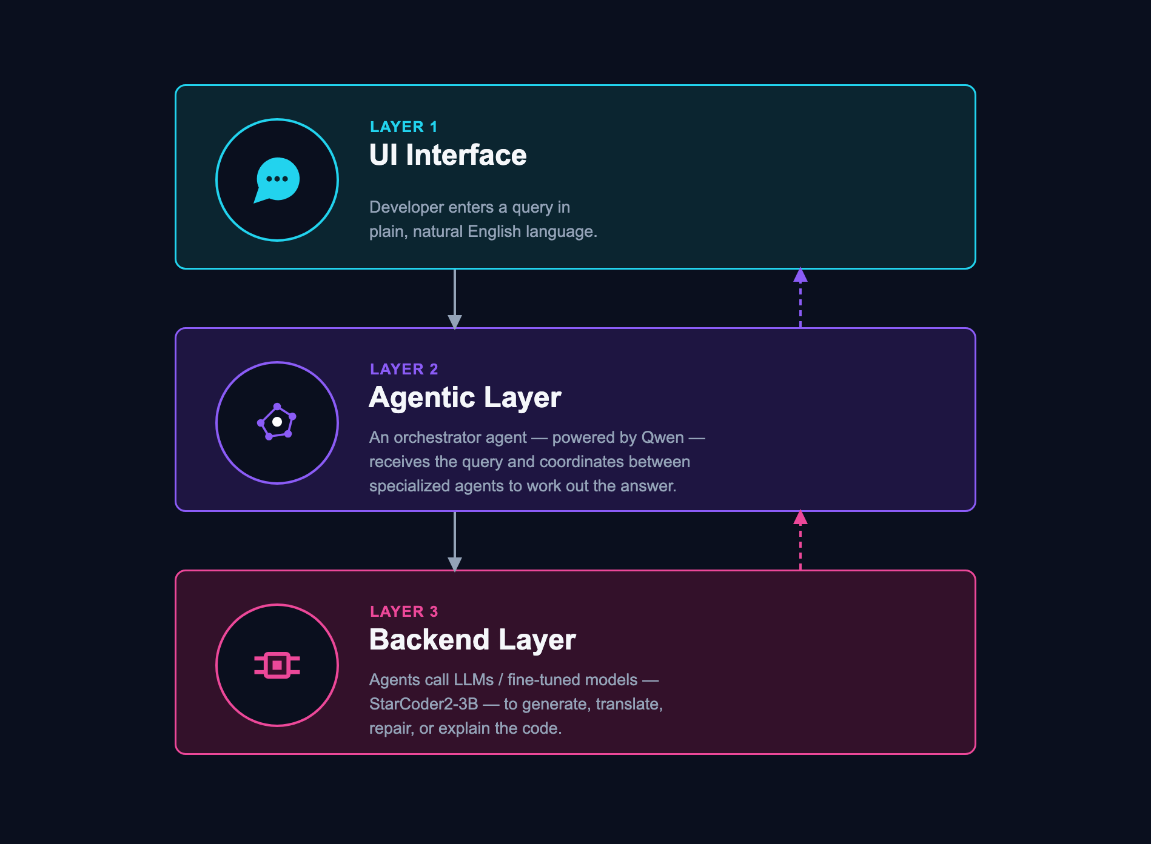
THE BIG PICTURE
Project Architecture at a Glance
CodeGen Agentic AI System • Group 19
04

Slide 4
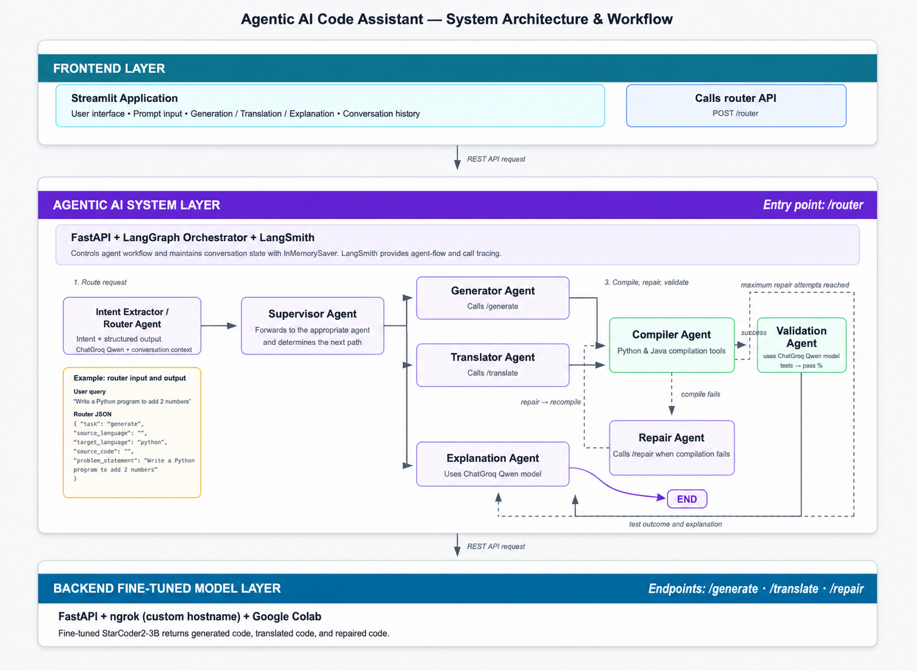
CodeGen Agentic AI System • Group 19

Slide 5

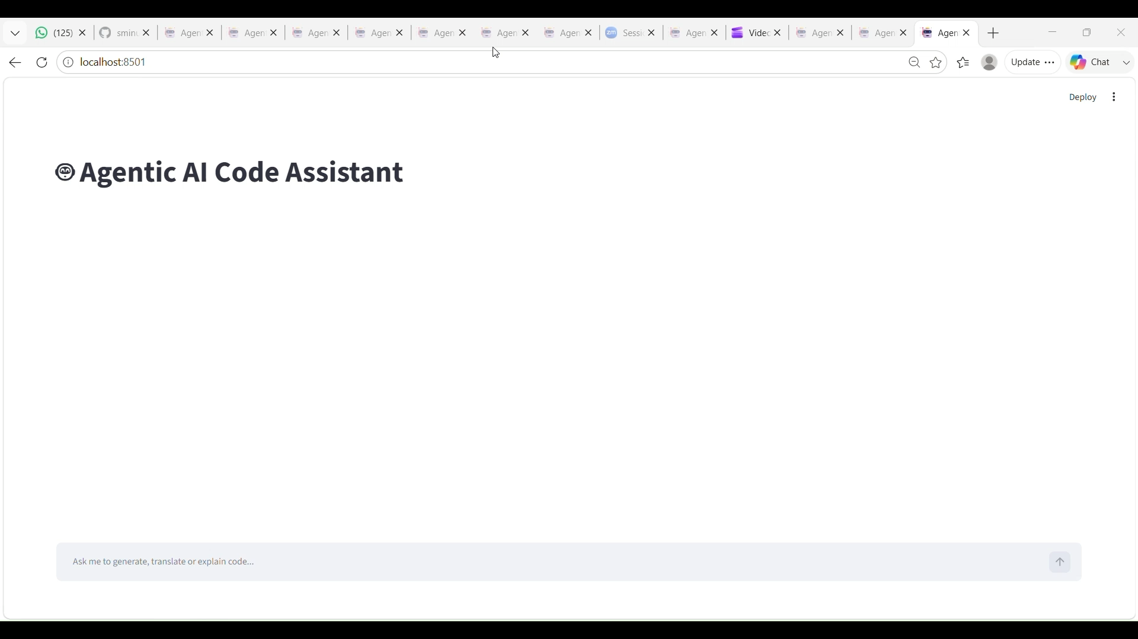
Live Demo — Video Walkthrough
End-to-end recorded walkthrough of the Streamlit chat interface generating, explaining, and translating code.
CodeGen Agentic AI System • Group 19
06

Slide 6

CONTEXT AWARENESS
Conversational / Multi-Turn Memory
Short-Term Memory: InMemorySaver
• Stores recent conversation history during the current session.
• Enables the Intent Extractor/Router Agent to infer user intent from previous interactions.
• Resolves context-dependent queries such as "convert the above code" or "explain the above code".
• Improves intent classification for follow-up requests without requiring the user to repeat the code.
• Session-based memory that is cleared when the application ends (non-persistent).
• context window size - 256k tokens
• Open question — strategy when context is full?
CodeGen Agentic AI System • Group 19
07

Slide 7
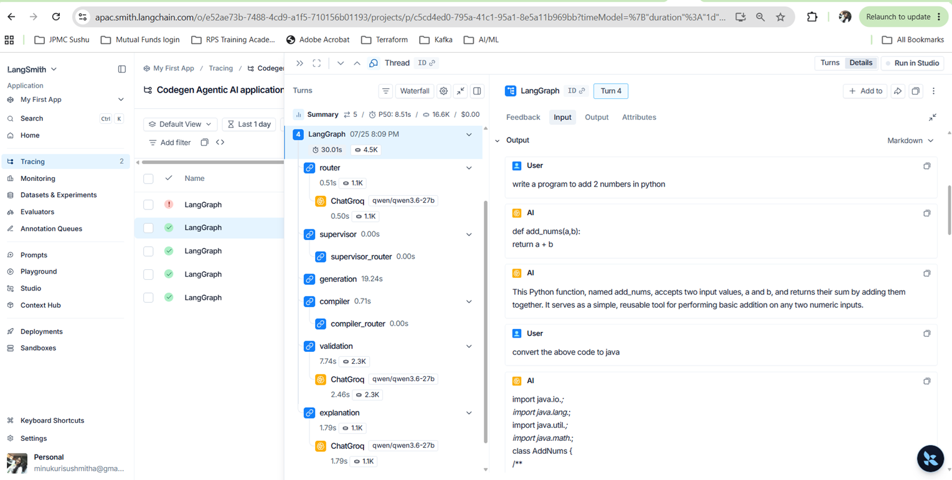
LangSmith — Agent Call Tracing
Full LangGraph run trace: router → supervisor → generation → compiler → validation → explanation, each hop calling ChatGroq qwen/qwen3.6-27b with latency and token counts.
CodeGen Agentic AI System • Group 19
20

Slide 8
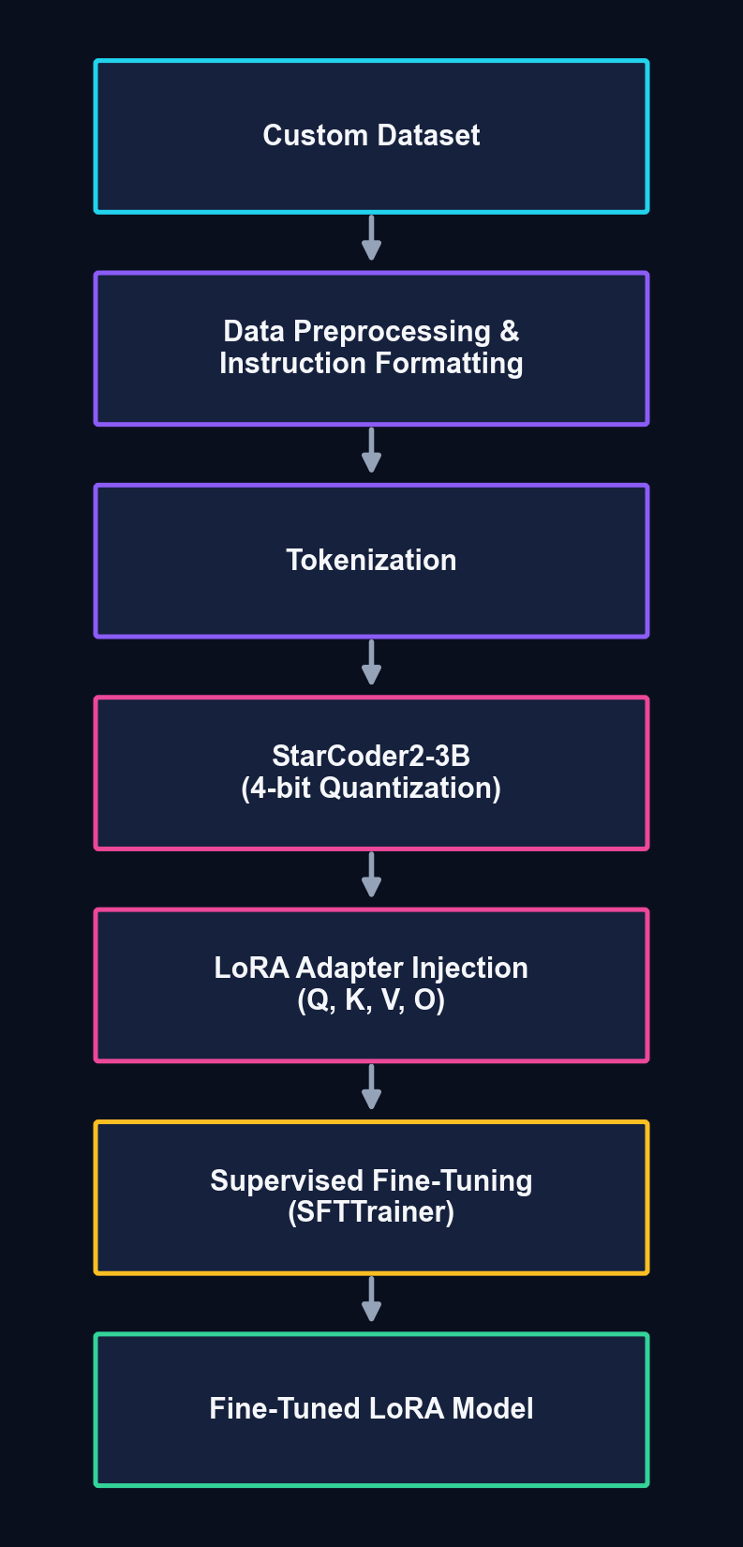
END-TO-END PIPELINE
Fine-Tuning Workflow
CodeGen Agentic AI System • Group 19
12

Slide 9

TEACHING THE MODEL
Fine-Tuning Overview
Base Model
StarCoder2-3B (BigCode)
Fine-Tuning Technique
Parameter-Efficient Fine-Tuning (PEFT) using QLoRA · Rank 16, Alpha 32
Training Framework
Hugging Face Transformers + TRL (SFTTrainer)
Execution Environment
Google Colab GPU
CodeGen Agentic AI System • Group 19
08

Slide 10
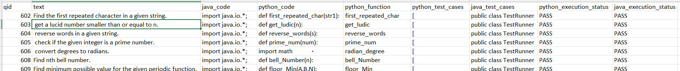
TRAINING DATA
Custom Dataset & Instruction Format
• StarCoder2 base model is trained for code completion, not instruction following — so we fine-tune it to follow instructions.
• Custom dataset: 332 samples per problem type → 4 × 332 = 1,328 samples total.
CUSTOM DATASET METRICS — JAVA ↔ PYTHON TRANSLATION PAIRS
0.5424
Mean AST Similarity Score
100%
Java Compilation Rate
98.80% / 98.53%
Java Pass@1
100%
Python Pass@1
Task | Instruction | Response
Text → Python | Natural Language | Python Code
Text → Java | Natural Language | Java Code
Java → Python | Java Code | Python Code
Python → Java | Python Code | Java Code
TRAINING SAMPLE FORMAT
### Instruction
<input>
### Response
<expected output>
SAMPLE DATASET ROWS
CodeGen Agentic AI System • Group 19
09

Slide 11

MEMORY OPTIMIZATION
Model Quantization
To reduce GPU memory usage, 4-bit NF4 quantization was applied.
4-bit
NF4
Enabled
bfloat16
Quantization
Type
Double Quantization
Compute Dtype
BENEFITS
✓ Lower GPU memory consumption
✓ Faster training
✓ Enables fine-tuning large language models on limited hardware
CodeGen Agentic AI System • Group 19
10

Slide 12
EFFICIENT FINE-TUNING
LoRA Configuration & Advantages
Instead of updating all model parameters, LoRA inserts trainable low-rank matrices into attention layers.
WHY LoRA — ADVANTAGES
✓ Only adapter weights are trained
✓ Original model weights remain frozen
✓ Significantly lower GPU memory usage
✓ Faster training time
✓ Lightweight adapter — easy to deploy
✓ Comparable performance to full fine-tuning
Parameter | Value
Rank (r) | 16
Alpha | 32
Dropout | 0.05
Bias | None
Task Type | Causal Language Modeling
TARGET LAYERS (Q · K · V · O)
LoRA adapters are injected into the Query, Key, Value, and Output projection layers of the attention block.
CodeGen Agentic AI System • Group 19
11

Slide 13
HYPERPARAMETERS
Training Configuration
Parameter | Value
Epochs | 3
Batch Size | 1
Gradient Accumulation | 16
Effective Batch Size | 16
Learning Rate | 2 × 10⁻⁴
Precision | BF16
Optimizer | AdamW (default)
TRAINING FRAMEWORK
▸ Hugging Face Transformers
▸ TRL — SFTTrainer
▸ PEFT
CodeGen Agentic AI System • Group 19
13

Slide 14
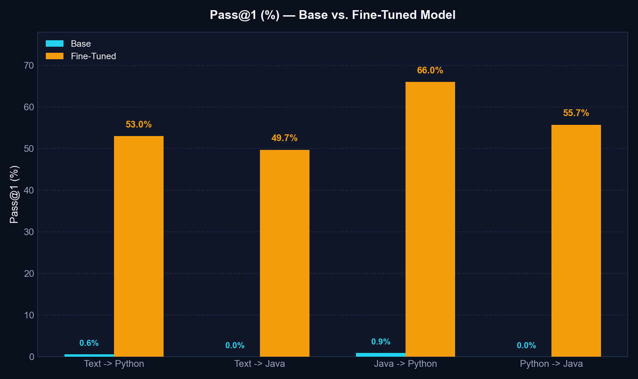
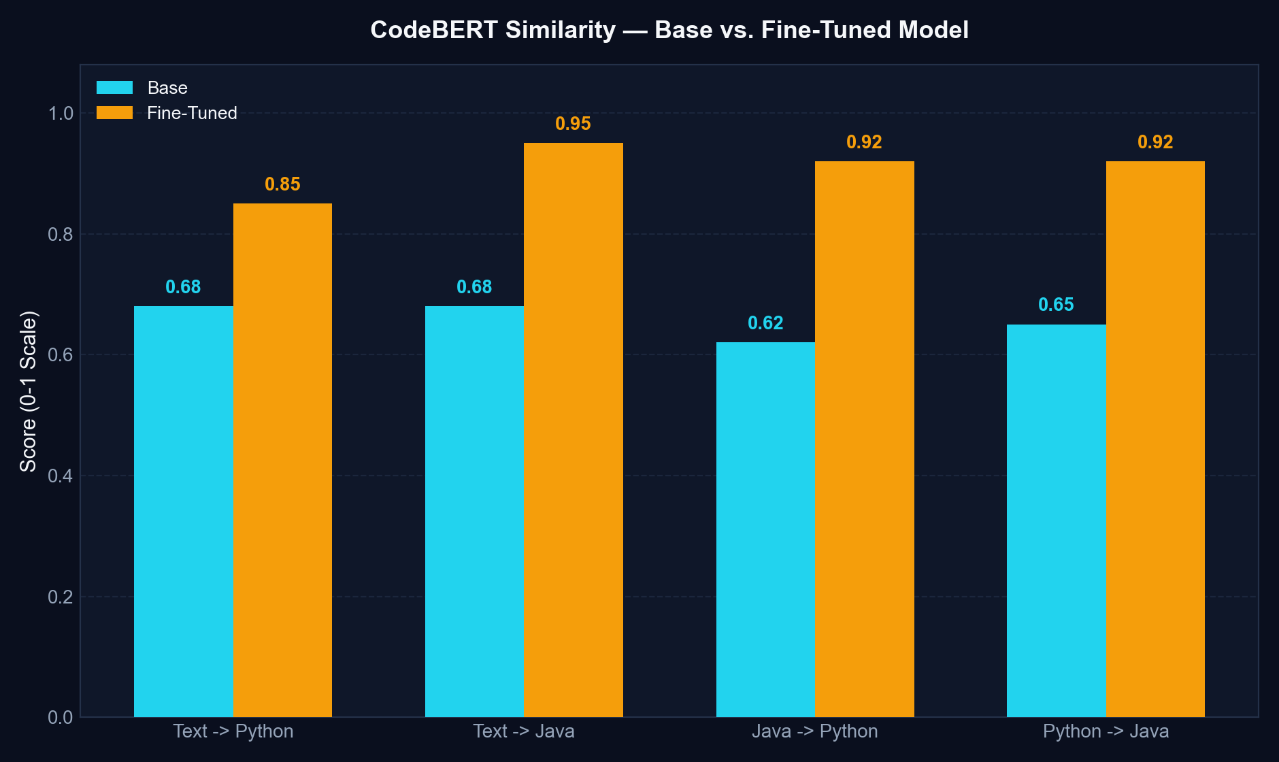
BASE VS. FINE-TUNED
Evaluation Results — Pass@1 & CodeBERT Similarity
CodeGen Agentic AI System • Group 19
14

Slide 15
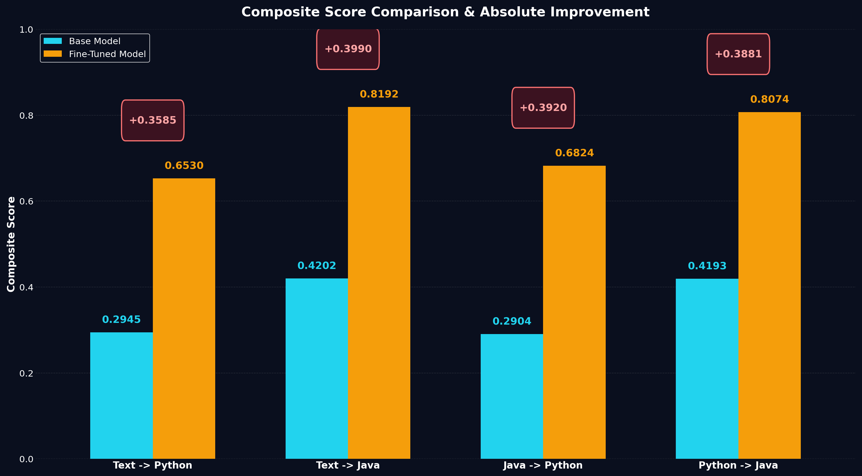
OVERALL GAIN
Evaluation Results — Composite Score Improvement
CodeGen Agentic AI System • Group 19
15

Slide 16
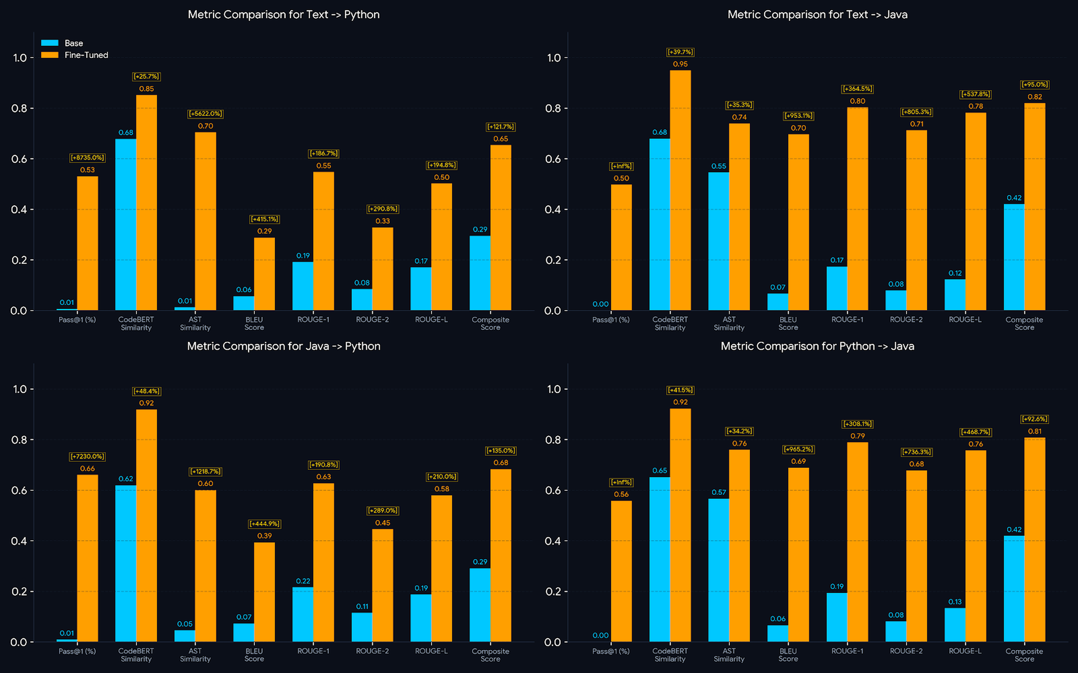
DEEP DIVE
Evaluation Results — Full Metric Breakdown
CodeGen Agentic AI System • Group 19
16

Slide 17
DEEP DIVE
MBPP Benchmark — Held-Out Dataset Results
MBPP BENCHMARK
(Text → Python)
44.05%
71.00%
Fine-Tuned Pass@1
Fine-Tuned Pass@10
Note: MBPP is an unknown/held-out dataset relative to fine-tuning data.
CodeGen Agentic AI System • Group 19
19

Slide 18
UNDER THE HOOD
Model Details & Endpoints
Generation / Translation / Repair
Code Explanation, Router & Validation
• Base model: bigcode/starcoder2-3b
• Dataset: custom dataset
• Fine-tuned (QLoRA) to follow instructions
• Explanation: qwen/qwen3.6-27b
• Router: qwen/qwen3.6-27b
• Validation (Test Case Generator): qwen/qwen3.6-27b
METRICS & CODE
Finetuning & Evaluation: github.com/nayanjha16/CodeGen-Implementations-May_26/blob/Group-19/README.md
Frontend: github.com/nayanjha16/CodeGen-Implementations-May_26/blob/Group-19-frontend/README.md
Agentic System: github.com/nayanjha16/CodeGen-Implementations-May_26/blob/Group-19-agentic-system-v1/README.md
Backend API (Fine-Tuned Model): github.com/nayanjha16/CodeGen-Implementations-May_26/blob/Group-19-backend-api-finetuned/README.md
CodeGen Agentic AI System • Group 19
17

Slide 19
WHAT'S NEXT
Next Steps
AWS/Azure Cloud Deployment
Integrate RAG
Move from local/Colab + ngrok hosting to a production cloud deployment.
Add Retrieval-Augmented Generation to improve grounding and performance.
Thank You
Questions & Discussion
CodeGen Agentic AI System • Group 19
18

